Slide 1
Agenda Helper
Demonstrator File
www.planning-helpers.com

Slide 2
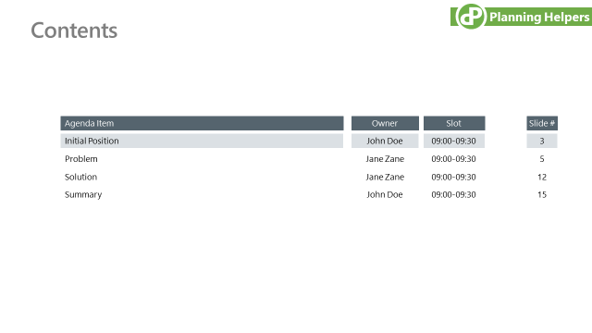
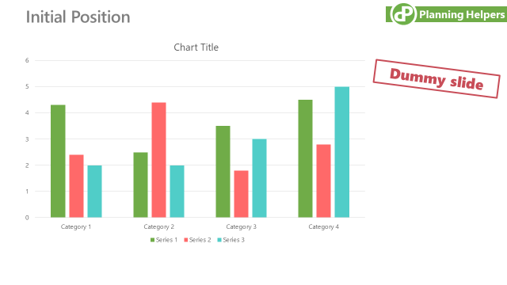
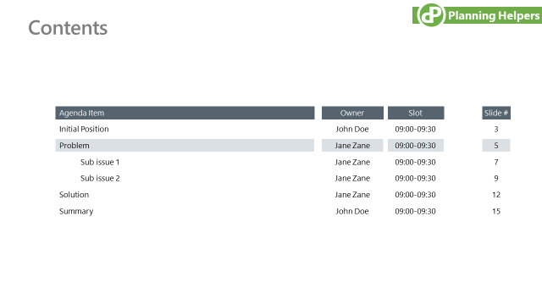
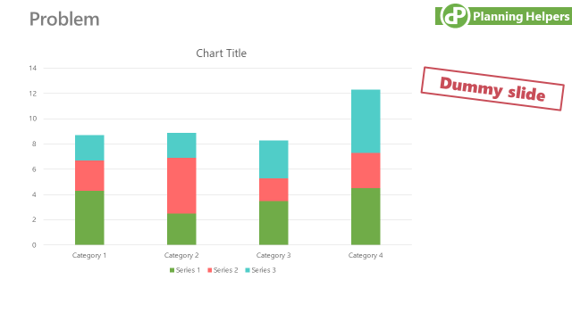
Agenda Helper creates and updates divider slides with great convenience
Layouts are freely customizable
Many default layouts provided
Hyperlinks allow ‘on click’ navigation between dividers
Full ‘undo’ functionality
Agenda Helper creates divider slides and keeps them in sync

Slide 3
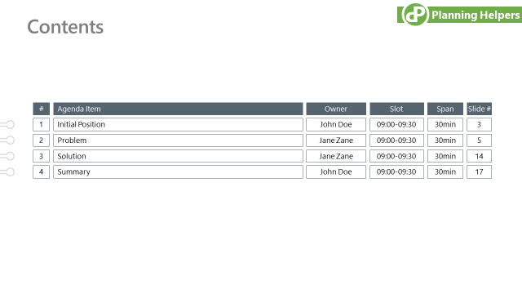
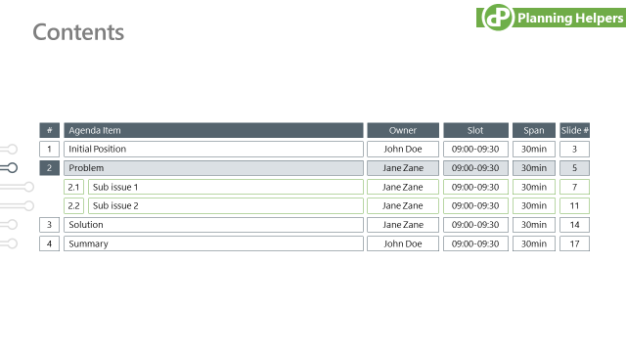
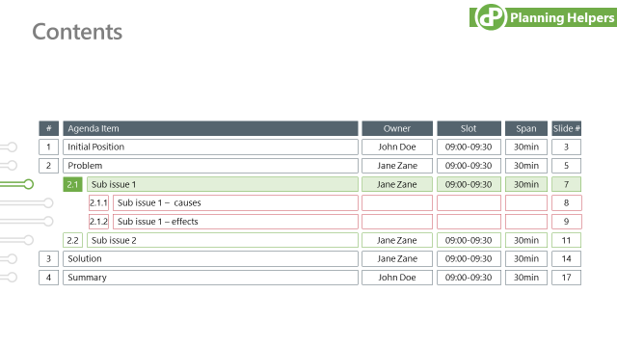
Customizable and flexible layouts
Three customizable columns maybe additionally shown, e.g. owner, time slot and time span
Outlines have up to two sub-levels
Sub-levels may be hidden on the main slide while shown on dividers of the respective chapter only
Sub-level formats are independent from the parents

Slide 4
Example Deck

Slide 5
Contents
Move unused boxes here outside of the printed area! e.g. presenter, span, slot, page or the entire row with the column headers
Format the placeholder boxes using the regular PowerPoint techniques!
Each row of boxes represents a level of your agenda outline:
Column Header
1. = Level 1
1. = Level 1 - highlighted as the current chapter
1.1 = Level 2
1.1 = Level 2 - highlighted as the current chapter
1.1.1 = Level 3
1.1.1 = Level 3 - highlighted as the current chapter
The POINTERS (grey arrows, in the default format) can be moved onto the slide and be used to highlight the current chapter.
<< Position of this red box: Distance of the agenda from the upper page border / Height of this box: Height of the space between rows
No.
Agenda Item
Owner
Slot
Span
Page
ID | Level | No. | Agenda Item | Owner | Slot | Span | Only show on Dividers of level 2 or 3 | Create Divider Slide | Auto No | Page
383881 | 1 | 1 | Initial position | John Doe | 09:00-09:30 | 30min | 1 | yes | ++1++++++
21448 | 1 | 2 | Problem | Jane Zane | 09:00-09:30 | 30min | 1 | yes | ++2++++++
346894 | 2 | 2.1 | Sub issue 1 | Jane Zane | 09:00-09:30 | 30min | 1 | yes | ++2.++1+++
396844 | 2 | 2.2 | Sub issue 2 | Jane Zane | 09:00-09:30 | 30min | 1 | yes | ++2.++2+++
961073 | 1 | 3 | Solution | Jane Zane | 09:00-09:30 | 30min | 1 | yes | ++3++++++
454961 | 2 | 3.1 | Sub-solution 1 | Jane Zane | 09:00-09:30 | 30min | 1 | yes | ++3.++1+++
38504 | 3 | 3.1.1 | Sub-solution 1 - Step 1 | Jane Zane | 09:00-09:30 | 30min | 1 | yes | ++3.++1.++1
764976 | 3 | 3.1.2 | Sub-solution 1 - Step 2 | Jane Zane | 09:00-09:30 | 30min | 1 | yes | ++3.++1.++2
148678 | 2 | 3.2 | Sub-solution 2 | Jane Zane | 09:00-09:30 | 30min | 1 | yes | ++3.++2+++
962176 | 1 | 4 | Summary | Jane Zane | 09:00-09:30 | 30min | 1 | yes | ++4++++++
1
Initial position
John Doe
09:00-09:30
30min
6
2
Problem
Jane Zane
09:00-09:30
30min
8
#
Item Name
Presenter
Slot
Span
Page
2.1
Sub issue 1
Jane Zane
09:00-09:30
30min
10
#
Item Name
Presenter
Slot
Span
Page
Pointer
2.2
Sub issue 2
Jane Zane
09:00-09:30
30min
12
#
Item Name
Presenter
Slot
Span
Page
Pointer
3
Solution
Jane Zane
09:00-09:30
30min
14
#
Item Name
Presenter
Slot
Span
Page
Pointer
3.1
Sub-solution 1
Jane Zane
09:00-09:30
30min
15
#
Item Name
Presenter
Slot
Span
Page
Pointer
3.1.1
Sub-solution 1 - Step 1
Jane Zane
09:00-09:30
30min
17
#
Item Name
Presenter
Slot
Span
Page
Pointer
3.1.2
Sub-solution 1 - Step 2
Jane Zane
09:00-09:30
30min
19
3.2
#
Item Name
Presenter
Slot
Span
Page
Pointer
Sub-solution 2
Jane Zane
09:00-09:30
30min
21
4
Summary
Jane Zane
09:00-09:30
30min
23
Agenda Master Slide
- This slide contains:
a) the agenda content data
b) the layout of your agenda
- Copy this slide to another presentation, if you want to use the same agenda there.
- Delete only, if you do no longer need the agenda data and layout.

Slide 6
Contents
No.
Agenda Item
Owner
Slot
Span
Page
1
Initial position
John Doe
09:00-09:30
30min
6
2
Problem
Jane Zane
09:00-09:30
30min
8
2.1
Sub issue 1
Jane Zane
09:00-09:30
30min
10
2.2
Sub issue 2
Jane Zane
09:00-09:30
30min
12
3
Solution
Jane Zane
09:00-09:30
30min
14
3.1
Sub-solution 1
Jane Zane
09:00-09:30
30min
15
3.1.1
Sub-solution 1 - Step 1
Jane Zane
09:00-09:30
30min
17
3.1.2
Sub-solution 1 - Step 2
Jane Zane
09:00-09:30
30min
19
3.2
Sub-solution 2
Jane Zane
09:00-09:30
30min
21
4
Summary
Jane Zane
09:00-09:30
30min
23

Slide 7
Initial Position

Slide 8
Contents
No.
Agenda Item
Owner
Slot
Span
Page
1
Initial position
John Doe
09:00-09:30
30min
6
2
Problem
Jane Zane
09:00-09:30
30min
8
2.1
Sub issue 1
Jane Zane
09:00-09:30
30min
10
2.2
Sub issue 2
Jane Zane
09:00-09:30
30min
12
3
Solution
Jane Zane
09:00-09:30
30min
14
3.1
Sub-solution 1
Jane Zane
09:00-09:30
30min
15
3.1.1
Sub-solution 1 - Step 1
Jane Zane
09:00-09:30
30min
17
3.1.2
Sub-solution 1 - Step 2
Jane Zane
09:00-09:30
30min
19
3.2
Sub-solution 2
Jane Zane
09:00-09:30
30min
21
4
Summary
Jane Zane
09:00-09:30
30min
23

Slide 9
Problem

Slide 10
Contents
No.
Agenda Item
Owner
Slot
Span
Page
1
Initial position
John Doe
09:00-09:30
30min
6
2
Problem
Jane Zane
09:00-09:30
30min
8
2.1
Sub issue 1
Jane Zane
09:00-09:30
30min
10
2.2
Sub issue 2
Jane Zane
09:00-09:30
30min
12
3
Solution
Jane Zane
09:00-09:30
30min
14
3.1
Sub-solution 1
Jane Zane
09:00-09:30
30min
15
3.1.1
Sub-solution 1 - Step 1
Jane Zane
09:00-09:30
30min
17
3.1.2
Sub-solution 1 - Step 2
Jane Zane
09:00-09:30
30min
19
3.2
Sub-solution 2
Jane Zane
09:00-09:30
30min
21
4
Summary
Jane Zane
09:00-09:30
30min
23

Slide 11
Sub issue 1

Slide 12
Contents
No.
Agenda Item
Owner
Slot
Span
Page
1
Initial position
John Doe
09:00-09:30
30min
6
2
Problem
Jane Zane
09:00-09:30
30min
8
2.1
Sub issue 1
Jane Zane
09:00-09:30
30min
10
2.2
Sub issue 2
Jane Zane
09:00-09:30
30min
12
3
Solution
Jane Zane
09:00-09:30
30min
14
3.1
Sub-solution 1
Jane Zane
09:00-09:30
30min
15
3.1.1
Sub-solution 1 - Step 1
Jane Zane
09:00-09:30
30min
17
3.1.2
Sub-solution 1 - Step 2
Jane Zane
09:00-09:30
30min
19
3.2
Sub-solution 2
Jane Zane
09:00-09:30
30min
21
4
Summary
Jane Zane
09:00-09:30
30min
23

Slide 13
Sub issue 2

Slide 14
Contents
No.
Agenda Item
Owner
Slot
Span
Page
1
Initial position
John Doe
09:00-09:30
30min
6
2
Problem
Jane Zane
09:00-09:30
30min
8
2.1
Sub issue 1
Jane Zane
09:00-09:30
30min
10
2.2
Sub issue 2
Jane Zane
09:00-09:30
30min
12
3
Solution
Jane Zane
09:00-09:30
30min
14
3.1
Sub-solution 1
Jane Zane
09:00-09:30
30min
15
3.1.1
Sub-solution 1 - Step 1
Jane Zane
09:00-09:30
30min
17
3.1.2
Sub-solution 1 - Step 2
Jane Zane
09:00-09:30
30min
19
3.2
Sub-solution 2
Jane Zane
09:00-09:30
30min
21
4
Summary
Jane Zane
09:00-09:30
30min
23

Slide 15
Contents
No.
Agenda Item
Owner
Slot
Span
Page
1
Initial position
John Doe
09:00-09:30
30min
6
2
Problem
Jane Zane
09:00-09:30
30min
8
2.1
Sub issue 1
Jane Zane
09:00-09:30
30min
10
2.2
Sub issue 2
Jane Zane
09:00-09:30
30min
12
3
Solution
Jane Zane
09:00-09:30
30min
14
3.1
Sub-solution 1
Jane Zane
09:00-09:30
30min
15
3.1.1
Sub-solution 1 - Step 1
Jane Zane
09:00-09:30
30min
17
3.1.2
Sub-solution 1 - Step 2
Jane Zane
09:00-09:30
30min
19
3.2
Sub-solution 2
Jane Zane
09:00-09:30
30min
21
4
Summary
Jane Zane
09:00-09:30
30min
23

Slide 16
Sub solution 1

Slide 17
Contents
No.
Agenda Item
Owner
Slot
Span
Page
1
Initial position
John Doe
09:00-09:30
30min
6
2
Problem
Jane Zane
09:00-09:30
30min
8
2.1
Sub issue 1
Jane Zane
09:00-09:30
30min
10
2.2
Sub issue 2
Jane Zane
09:00-09:30
30min
12
3
Solution
Jane Zane
09:00-09:30
30min
14
3.1
Sub-solution 1
Jane Zane
09:00-09:30
30min
15
3.1.1
Sub-solution 1 - Step 1
Jane Zane
09:00-09:30
30min
17
3.1.2
Sub-solution 1 - Step 2
Jane Zane
09:00-09:30
30min
19
3.2
Sub-solution 2
Jane Zane
09:00-09:30
30min
21
4
Summary
Jane Zane
09:00-09:30
30min
23

Slide 18
Sub solution 1 – Step 1

Slide 19
Contents
No.
Agenda Item
Owner
Slot
Span
Page
1
Initial position
John Doe
09:00-09:30
30min
6
2
Problem
Jane Zane
09:00-09:30
30min
8
2.1
Sub issue 1
Jane Zane
09:00-09:30
30min
10
2.2
Sub issue 2
Jane Zane
09:00-09:30
30min
12
3
Solution
Jane Zane
09:00-09:30
30min
14
3.1
Sub-solution 1
Jane Zane
09:00-09:30
30min
15
3.1.1
Sub-solution 1 - Step 1
Jane Zane
09:00-09:30
30min
17
3.1.2
Sub-solution 1 - Step 2
Jane Zane
09:00-09:30
30min
19
3.2
Sub-solution 2
Jane Zane
09:00-09:30
30min
21
4
Summary
Jane Zane
09:00-09:30
30min
23

Slide 20
Sub solution 1 – Step 2

Slide 21
Contents
No.
Agenda Item
Owner
Slot
Span
Page
1
Initial position
John Doe
09:00-09:30
30min
6
2
Problem
Jane Zane
09:00-09:30
30min
8
2.1
Sub issue 1
Jane Zane
09:00-09:30
30min
10
2.2
Sub issue 2
Jane Zane
09:00-09:30
30min
12
3
Solution
Jane Zane
09:00-09:30
30min
14
3.1
Sub-solution 1
Jane Zane
09:00-09:30
30min
15
3.1.1
Sub-solution 1 - Step 1
Jane Zane
09:00-09:30
30min
17
3.1.2
Sub-solution 1 - Step 2
Jane Zane
09:00-09:30
30min
19
3.2
Sub-solution 2
Jane Zane
09:00-09:30
30min
21
4
Summary
Jane Zane
09:00-09:30
30min
23

Slide 22
Sub solution 2

Slide 23
Contents
No.
Agenda Item
Owner
Slot
Span
Page
1
Initial position
John Doe
09:00-09:30
30min
6
2
Problem
Jane Zane
09:00-09:30
30min
8
2.1
Sub issue 1
Jane Zane
09:00-09:30
30min
10
2.2
Sub issue 2
Jane Zane
09:00-09:30
30min
12
3
Solution
Jane Zane
09:00-09:30
30min
14
3.1
Sub-solution 1
Jane Zane
09:00-09:30
30min
15
3.1.1
Sub-solution 1 - Step 1
Jane Zane
09:00-09:30
30min
17
3.1.2
Sub-solution 1 - Step 2
Jane Zane
09:00-09:30
30min
19
3.2
Sub-solution 2
Jane Zane
09:00-09:30
30min
21
4
Summary
Jane Zane
09:00-09:30
30min
23

Slide 24
Summary

