Slide 1
Agenda Helper
Demonstrator File
www.planning-helpers.com

Slide 2
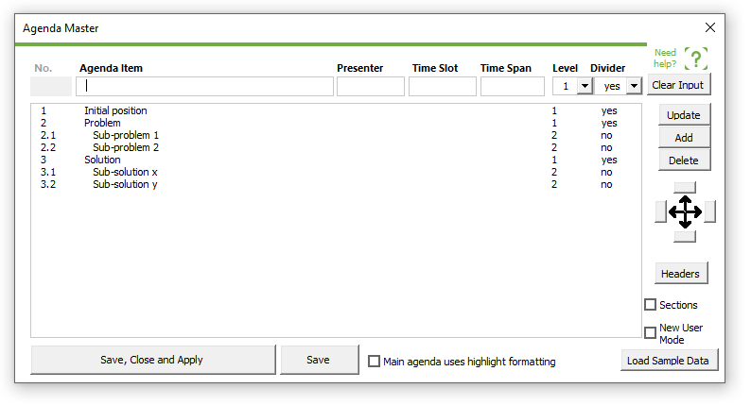
This presentation demonstrates how to collapse sub-chapters on a upper level
If in the Divider drop-down menu the option “no divider” is assinged to a sub-chapter, than there will be no divider slides created.
Sub-chapters do not have divider slides
Note: This presentation purposely contains only divider slides and no content slides

Slide 3
Contents
Move unused boxes here outside of the printed area! e.g. presenter, span, slot, page or the entire row with the column headers
Format the placeholder boxes using the regular PowerPoint techniques!
Each row of boxes represents a level of your agenda outline:
Column Header
1. = Level 1
1. = Level 1 - highlighted as the current chapter
1.1 = Level 2
1.1 = Level 2 - highlighted as the current chapter
1.1.1 = Level 3
1.1.1 = Level 3 - highlighted as the current chapter
The POINTERS (grey arrows, in the default format) can be moved onto the slide and be used to highlight the current chapter.
ID | Level | No. | Agenda Item | Owner | Slot | Span | Only show on Dividers of level 2 or 3 | Create Divider Slide | Auto No | Page
787365 | 1 | 1 | Initial position |  |  |  | 1 | yes | ++1++++++ | 4
821220 | 1 | 2 | Problem |  |  |  | 1 | yes | ++2++++++ | 5
973563 | 2 | 2.1 | Sub-problem 1 |  |  |  | 2 | no | ++2.++1+++
434822 | 2 | 2.2 | Sub-problem 2 |  |  |  | 2 | no | ++2.++2+++
954671 | 1 | 3 | Solution |  |  |  | 1 | yes | ++3++++++ | 6
488639 | 2 | 3.1 | Sub-solution x |  |  |  | 2 | no | ++3.++1+++
162037 | 2 | 3.2 | Sub-solution y |  |  |  | 2 | no | ++3.++2+++
1
Initial position
4
#
Item Name
Owner
Slot
Span
Page
#
Item Name
Owner
Slot
Span
Page
2
Problem
5
#
Item Name
Owner
Slot
Span
Page
3
Solution
6
#
Item Name
Owner
Slot
Span
Page
#
Item Name
Owner
Slot
Span
Page
#
Item Name
Owner
Slot
Span
Page
#
Item Name
Owner
Slot
Span
Page
Agenda Master Slide
- This slide contains:
a) the agenda content data
b) the layout of your agenda
- Copy this slide to another presentation, if you want to use the same agenda there.
- Delete only, if you do no longer need the agenda data and layout.

Slide 4
Contents
1
Initial position
4
2
Problem
5
3
Solution
6
On the main agenda, there is only Level 1 displayed. All sub-levels are collapsed

Slide 5
Contents
1
Initial position
4
2
Problem
5
2.1
Sub-problem 1
2.2
Sub-problem 2
3
Solution
6
There is no slide number, because there is no divider slide
On the divider slide of the ‘Solution’ chapter, the respective sub-chapters are expanded, but they do NOT have divider slides of their own

Slide 6
Contents
1
Initial position
4
2
Problem
5
3
Solution
6
3.1
Sub-solution x
3.2
Sub-solution y
There is no slide number, because there is no divider slide
On the divider slide of the ‘Solution’ chapter, the respective sub-chapters are expanded, but they do NOT have divider slides of their own

